Slide 1
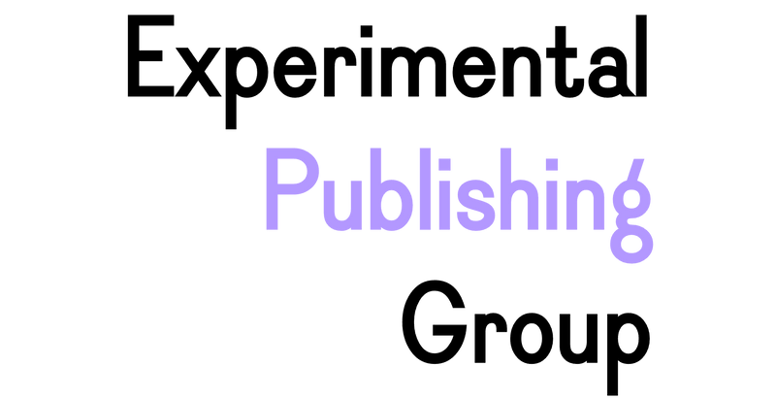

Promoting Interactions and Engagement with Scholarly Research: Speculations on the Advancement of Experimental Publishing
Janneke Adema
Copim/Open Book Futures
Centre for Postdigital Cultures, Coventry University
Open Monograph Publishing Workshop: Towards Sustainable Open Access Book Publishing in the Global South Context
University of Cape Town, 9-10 December 2024
2nd Global Summit on Diamond Open Access: Centering Social Justice in Scholarly Communication to Advance Research as a Public Good.

Slide 2
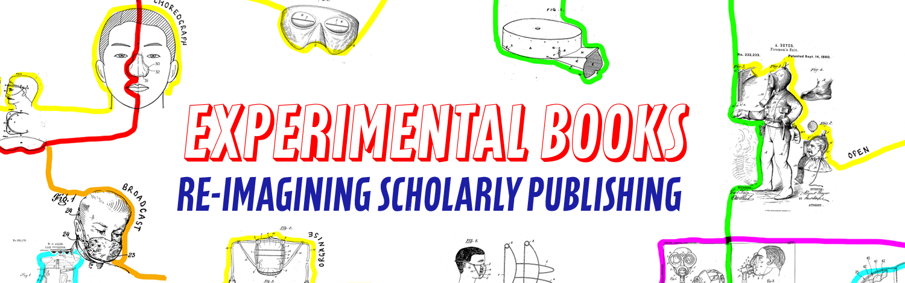

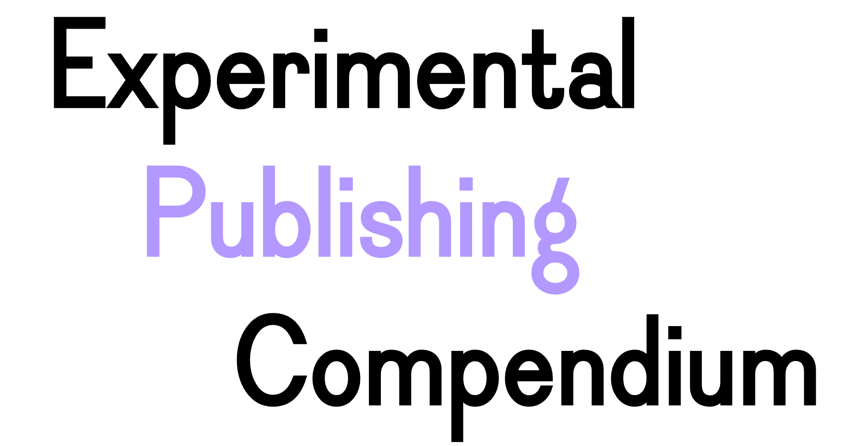


A community working to build a fairer, more open future for scholarly books: https://copim.pubpub.org/
The OBF project will significantly expand key infrastructures created by COPIM to
achieve a step change in how community-owned OA book publishing is delivered.
https://copim.pubpub.org/open-book-futures-project
a guide and reference which brings together tools, practices, and books to promote
the publication of experimental scholarly works. https://compendium.copim.ac.uk/
Our funders:

Slide 3
Situating Experimental Publishing
Experimental publishing examines, questions, critiques, and explores established publishing practices, workflows, and models, which reflect solidified print- and codex-based publishing conventions and neo-colonial and commercial hegemonies in academic publishing and knowledge production.
Experimental forms of publishing challenge the dominance of print-based processes within conventional forms of academic publishing (as being natural and the most suitable for all forms of research), and question models and relationalities of knowledge production that simply reproduce humanist, neoliberal, and epistemic legacy systems, which are often taken for granted or repeated uncritically.

Slide 4
Different kinds of experiments
Experiments with the form and format of the scholarly book;
Experiments with the various (multi)media through which books can be performed;
Experiments with the ways in which scholarship can be produced, disseminated, and consumed;
Experiments that reimagine the relationalities that constitute academic writing, research, and publishing.

Slide 5
Scholarly Interaction Around Open Access Books
Open Annotations
Open Peer Review
Remix and Reuse
Open and Social Scholarship
Versioning and Processual Publishing

Slide 6
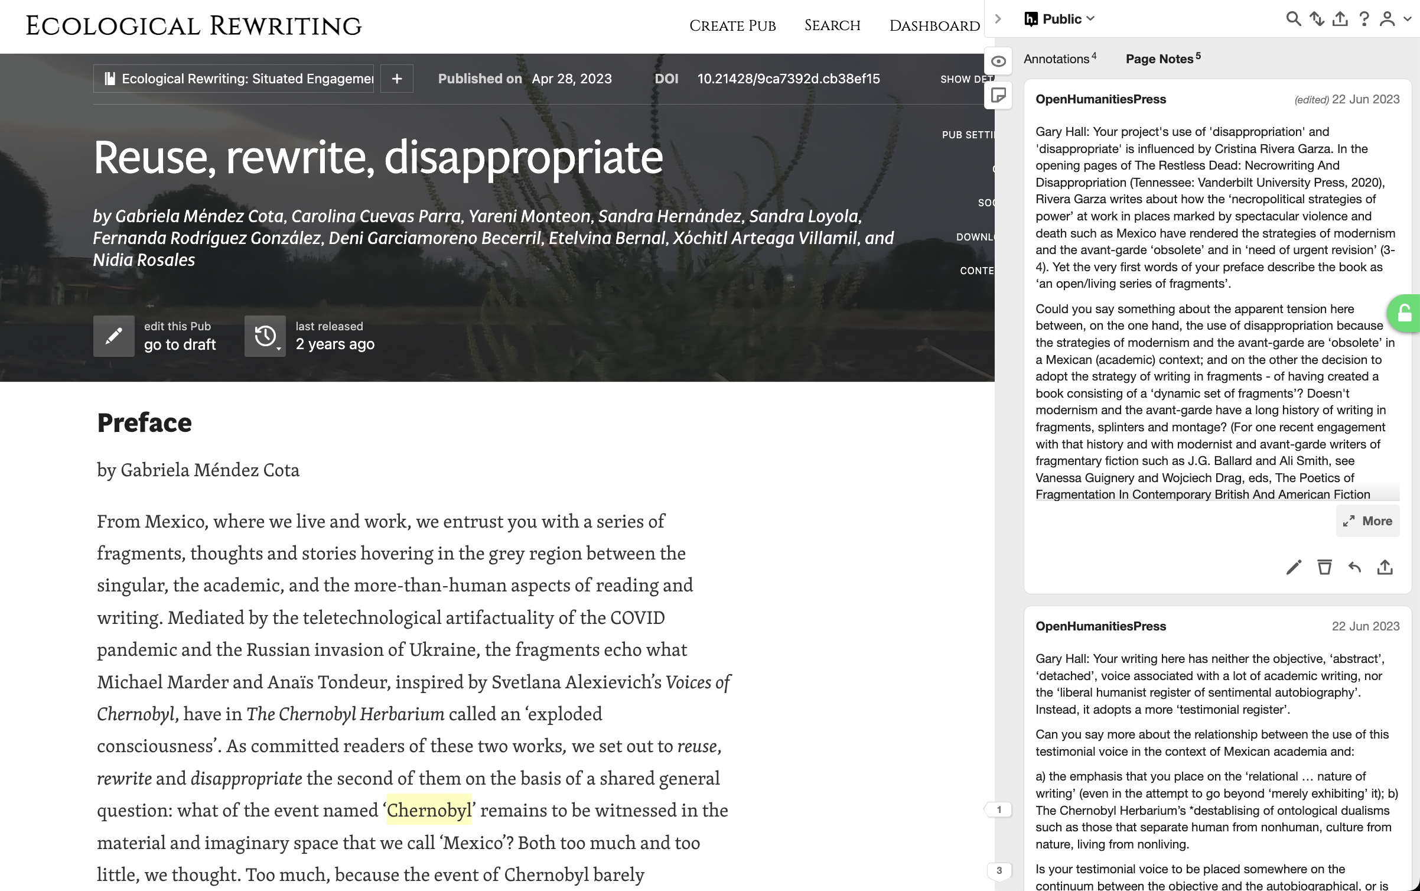
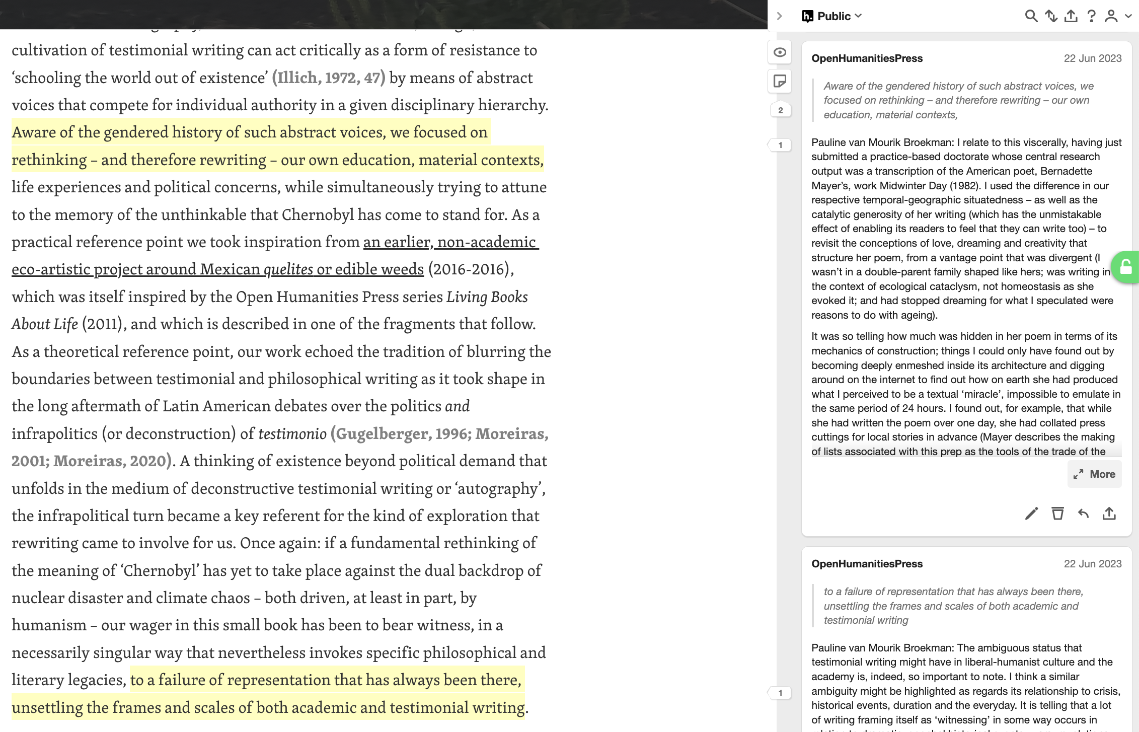

Slide 7
Scholarly Interaction Around Open Access Books
Open Annotations
Open Peer Review
Remix and Reuse
Open and Social Scholarship
Versioning and Processual Publishing

Slide 9
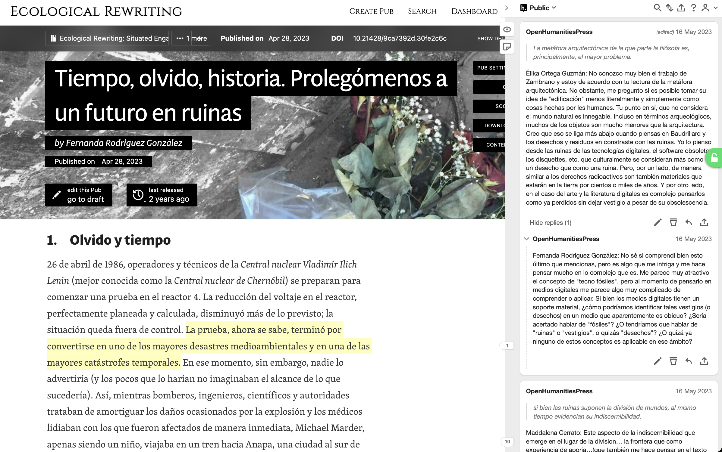

Slide 10
Scholarly Interaction Around Open Access Books
Open Annotations
Open Peer Review
Remix and Reuse
Open and Social Scholarship
Versioning and Processual Publishing

Slide 11
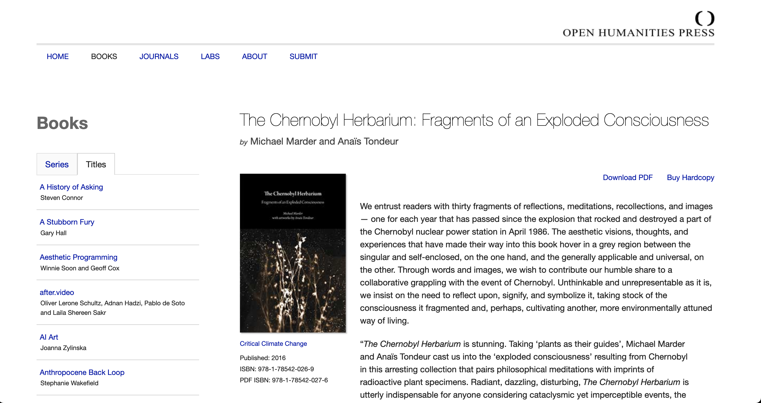

Slide 12
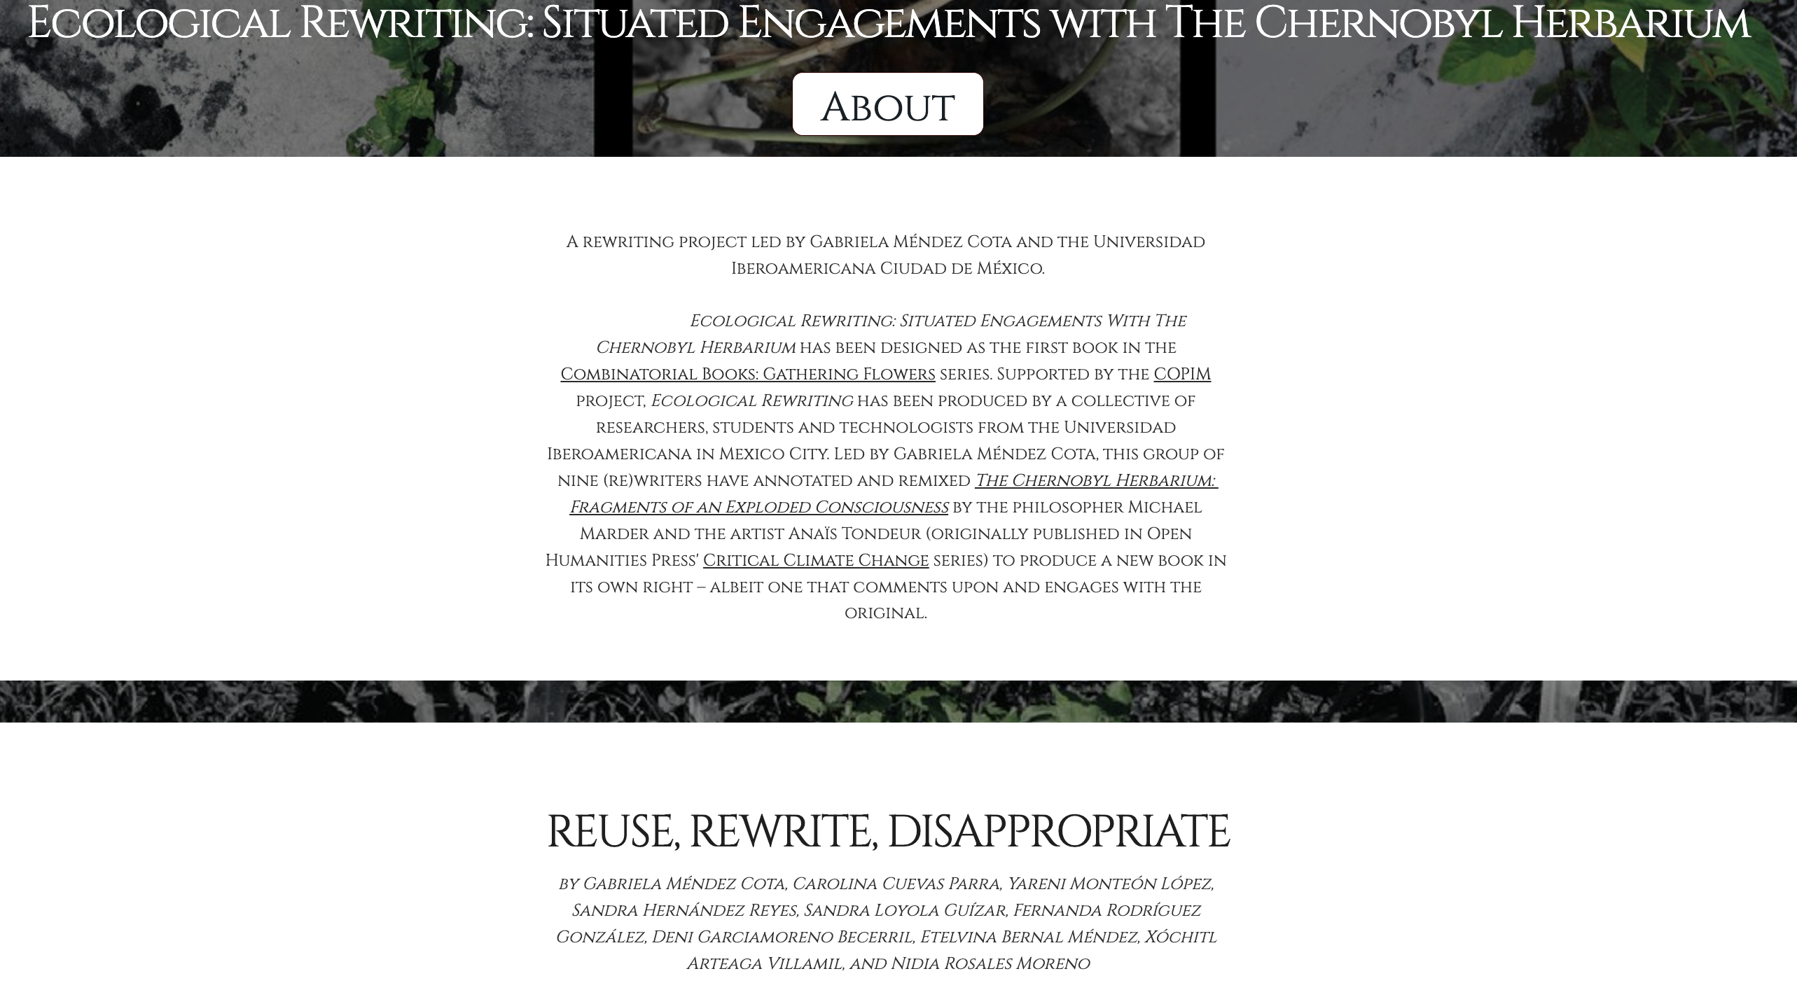
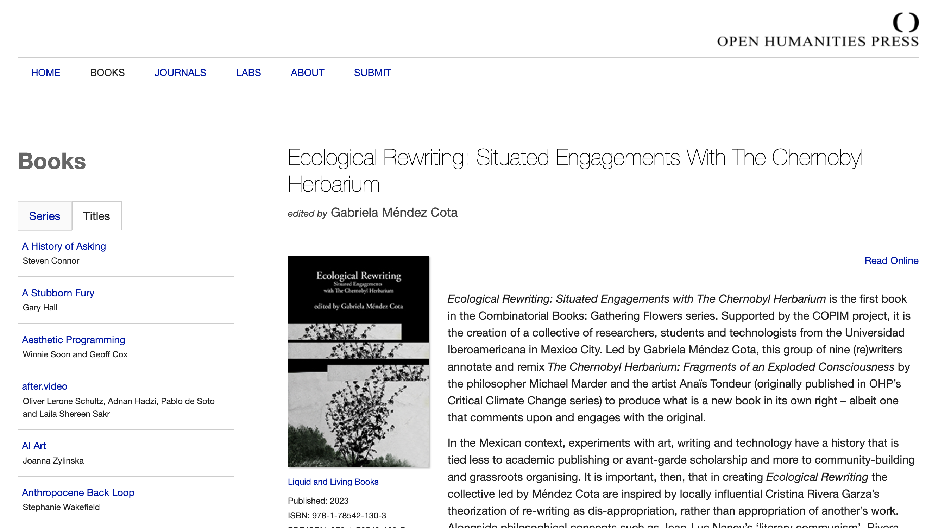
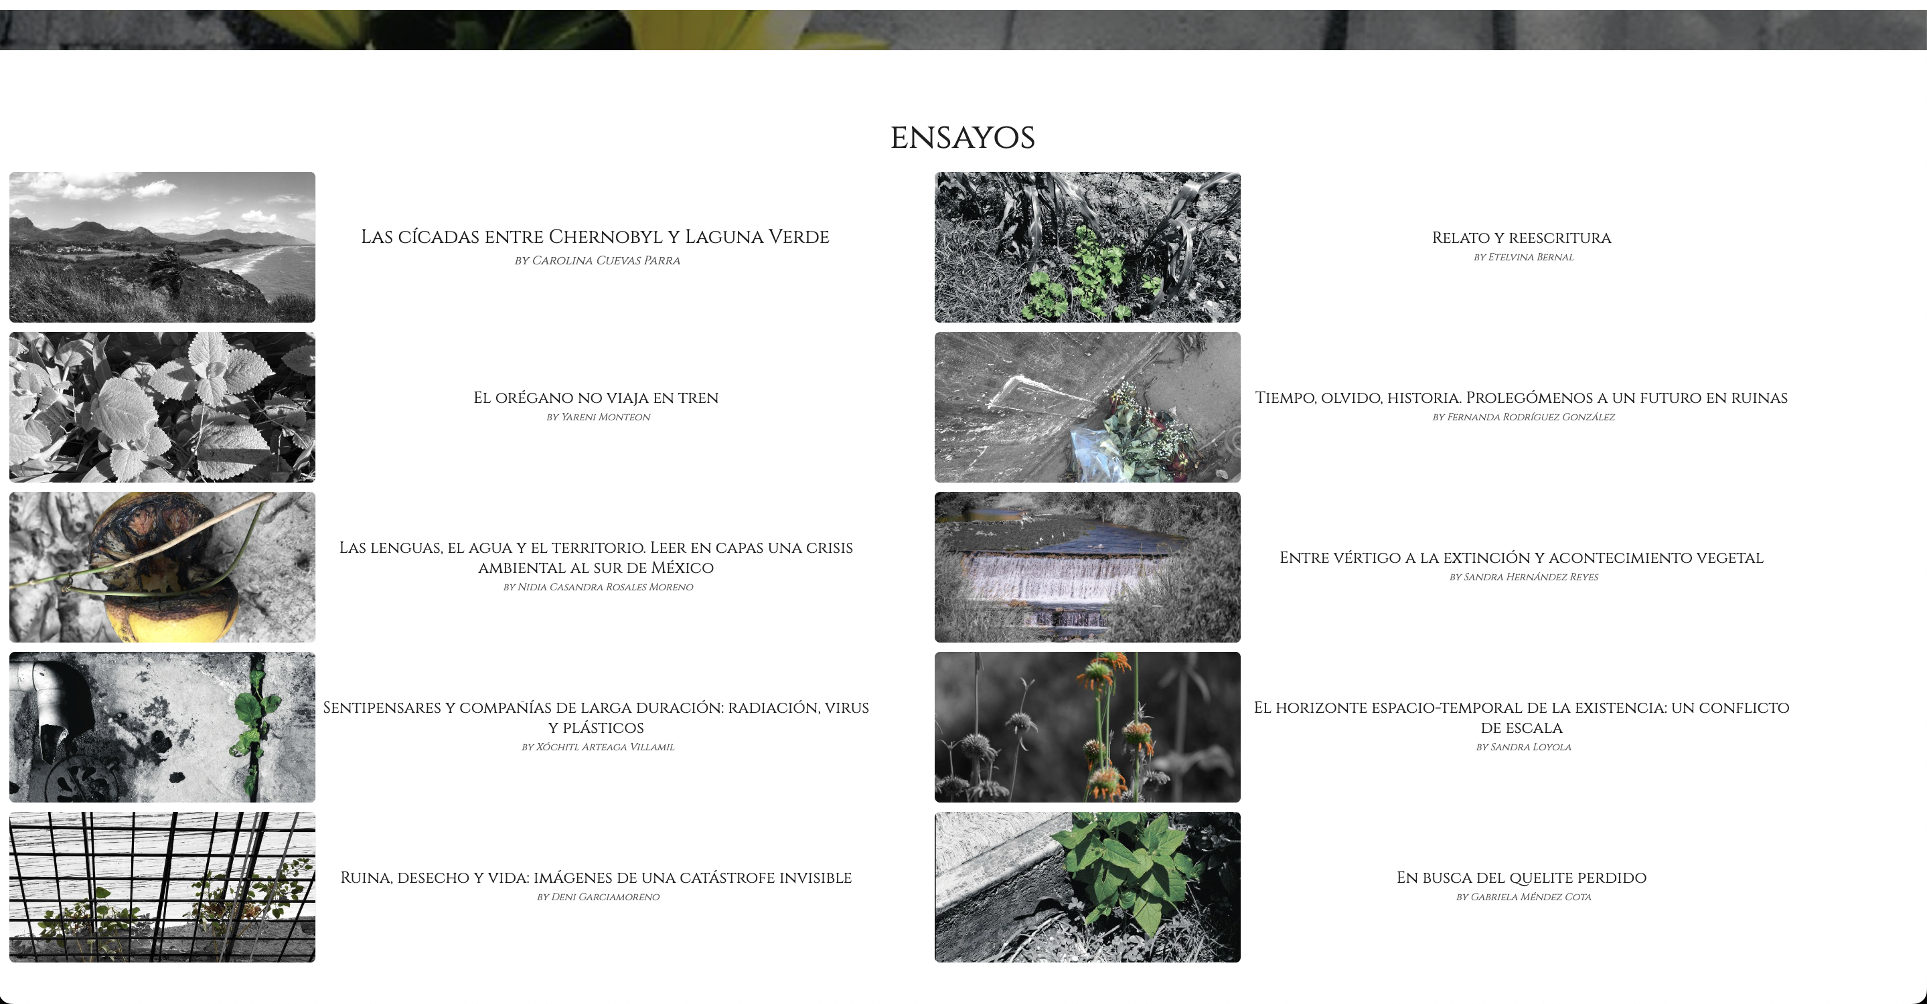
Ecological Rewriting: Situated Engagements
with The Chernobyl Herbarium, ed. Gabriela
Méndez Cota, Open Humanities Press, 2023
https://doi.org/10.21428/9ca7392d.07cdfb82

Slide 13
Scholarly Interaction Around Open Access Books
Open Annotations
Open Peer Review
Remix and Reuse
Open and Social Scholarship
Versioning and Processual Publishing

Slide 14
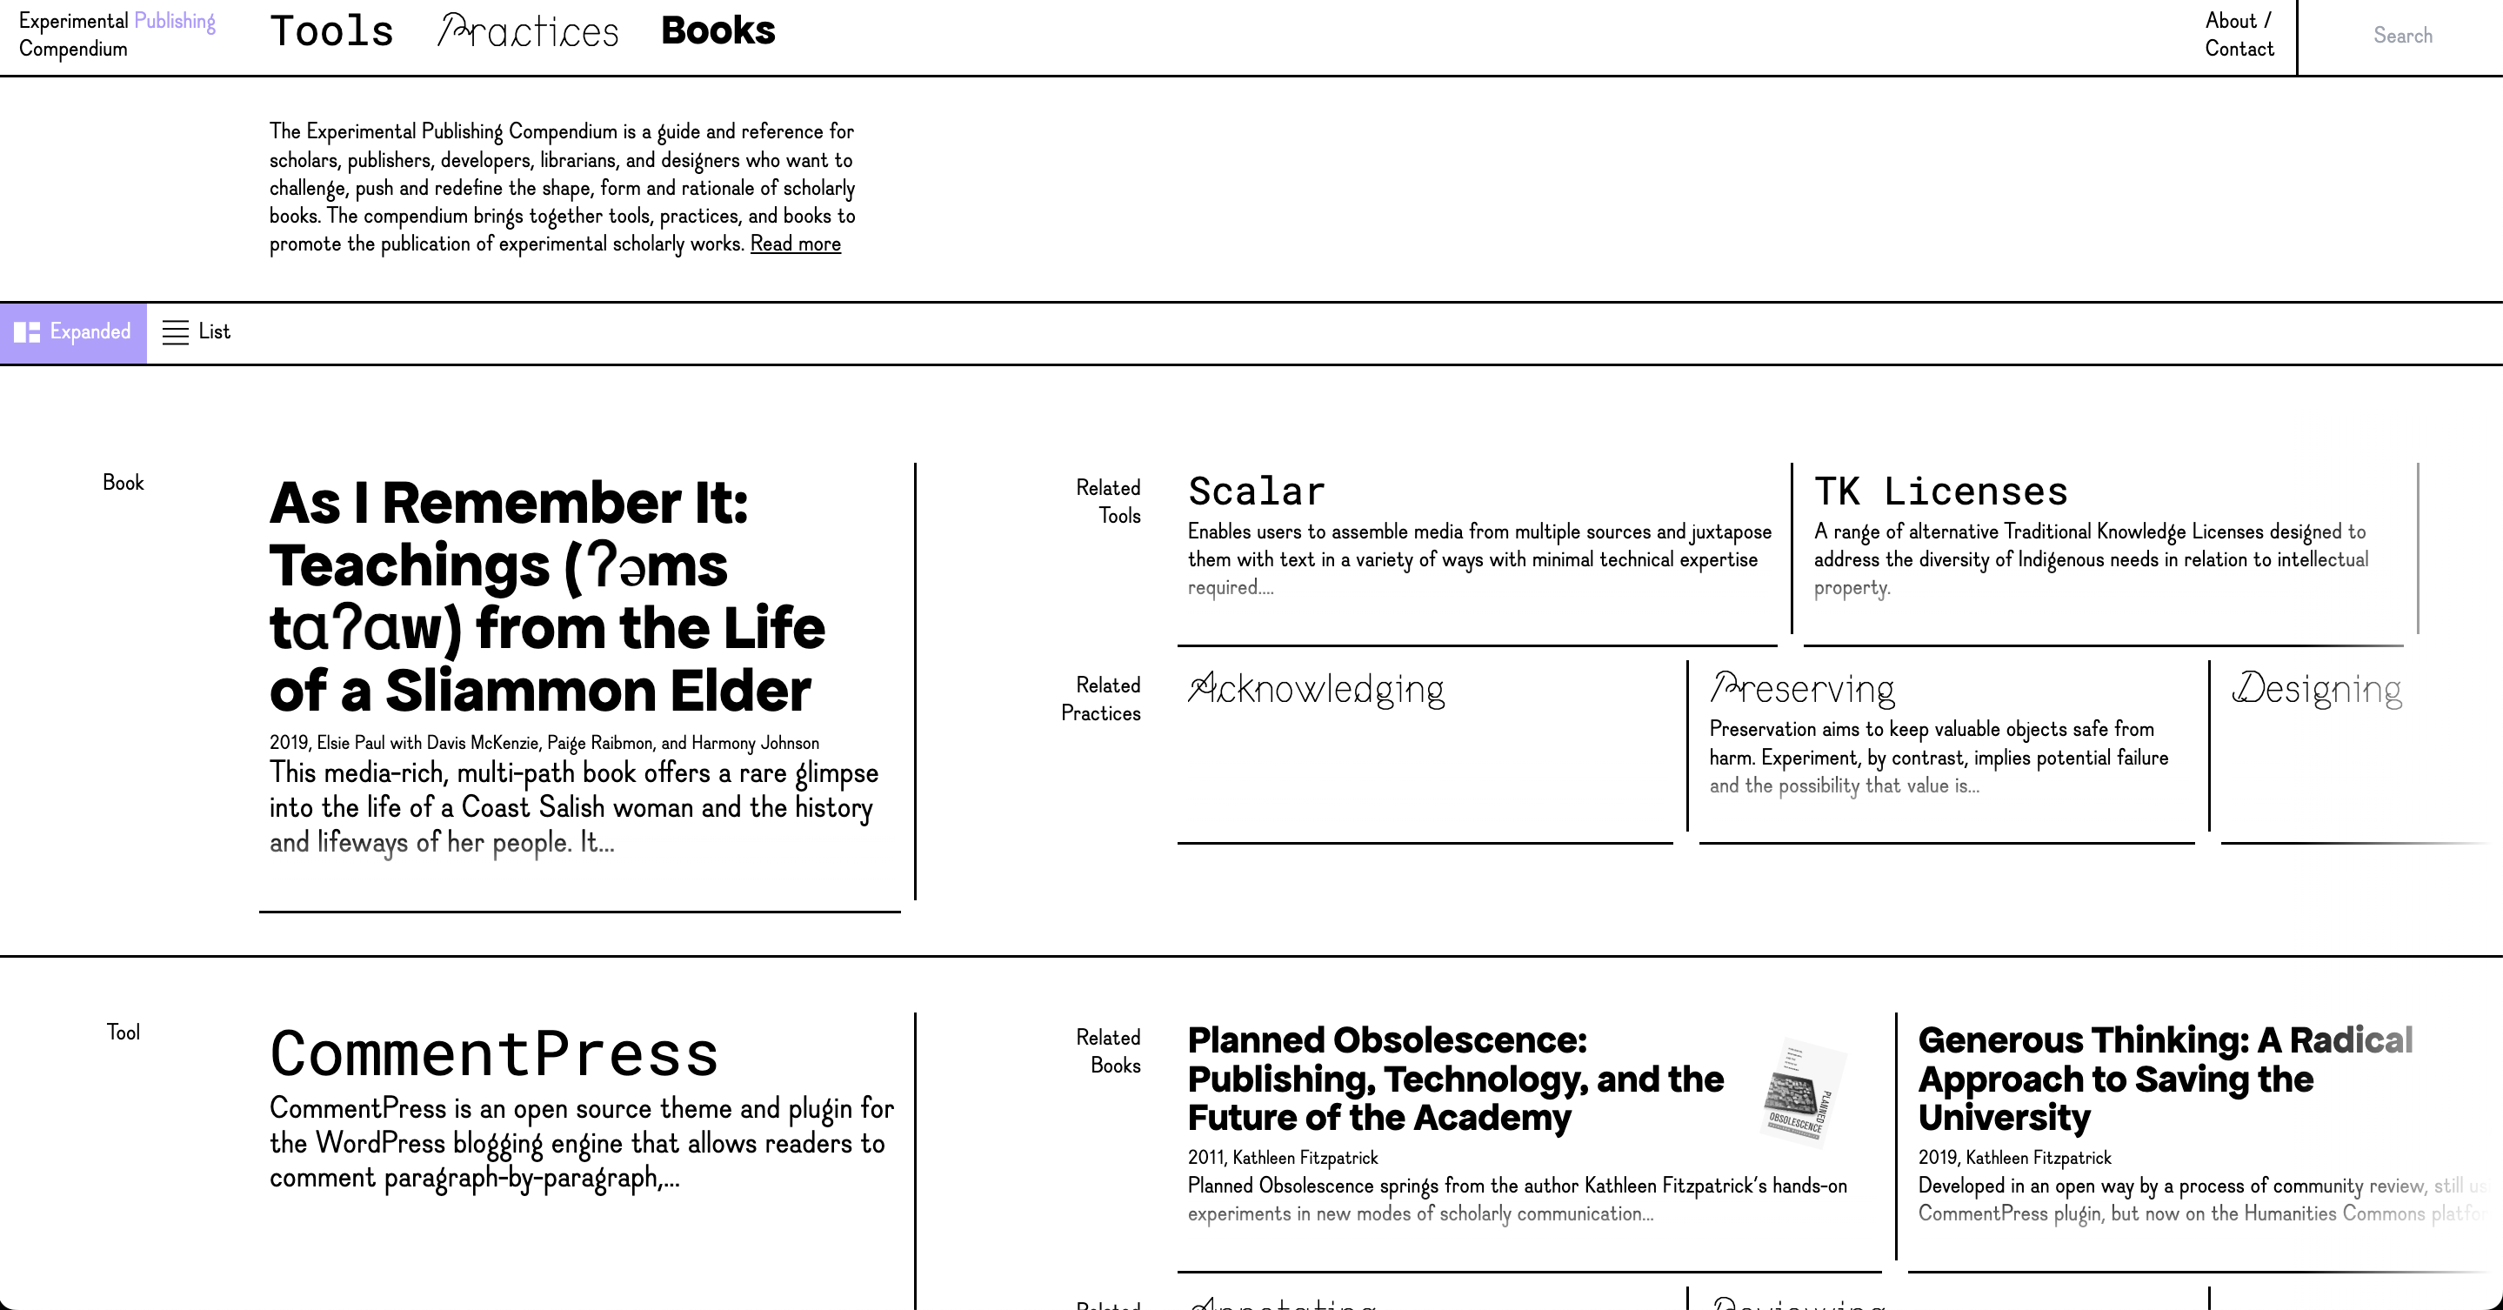
Experimental Publishing Compendium https://compendium.copim.ac.uk/
https://compendium.copim.ac.uk/

Slide 15
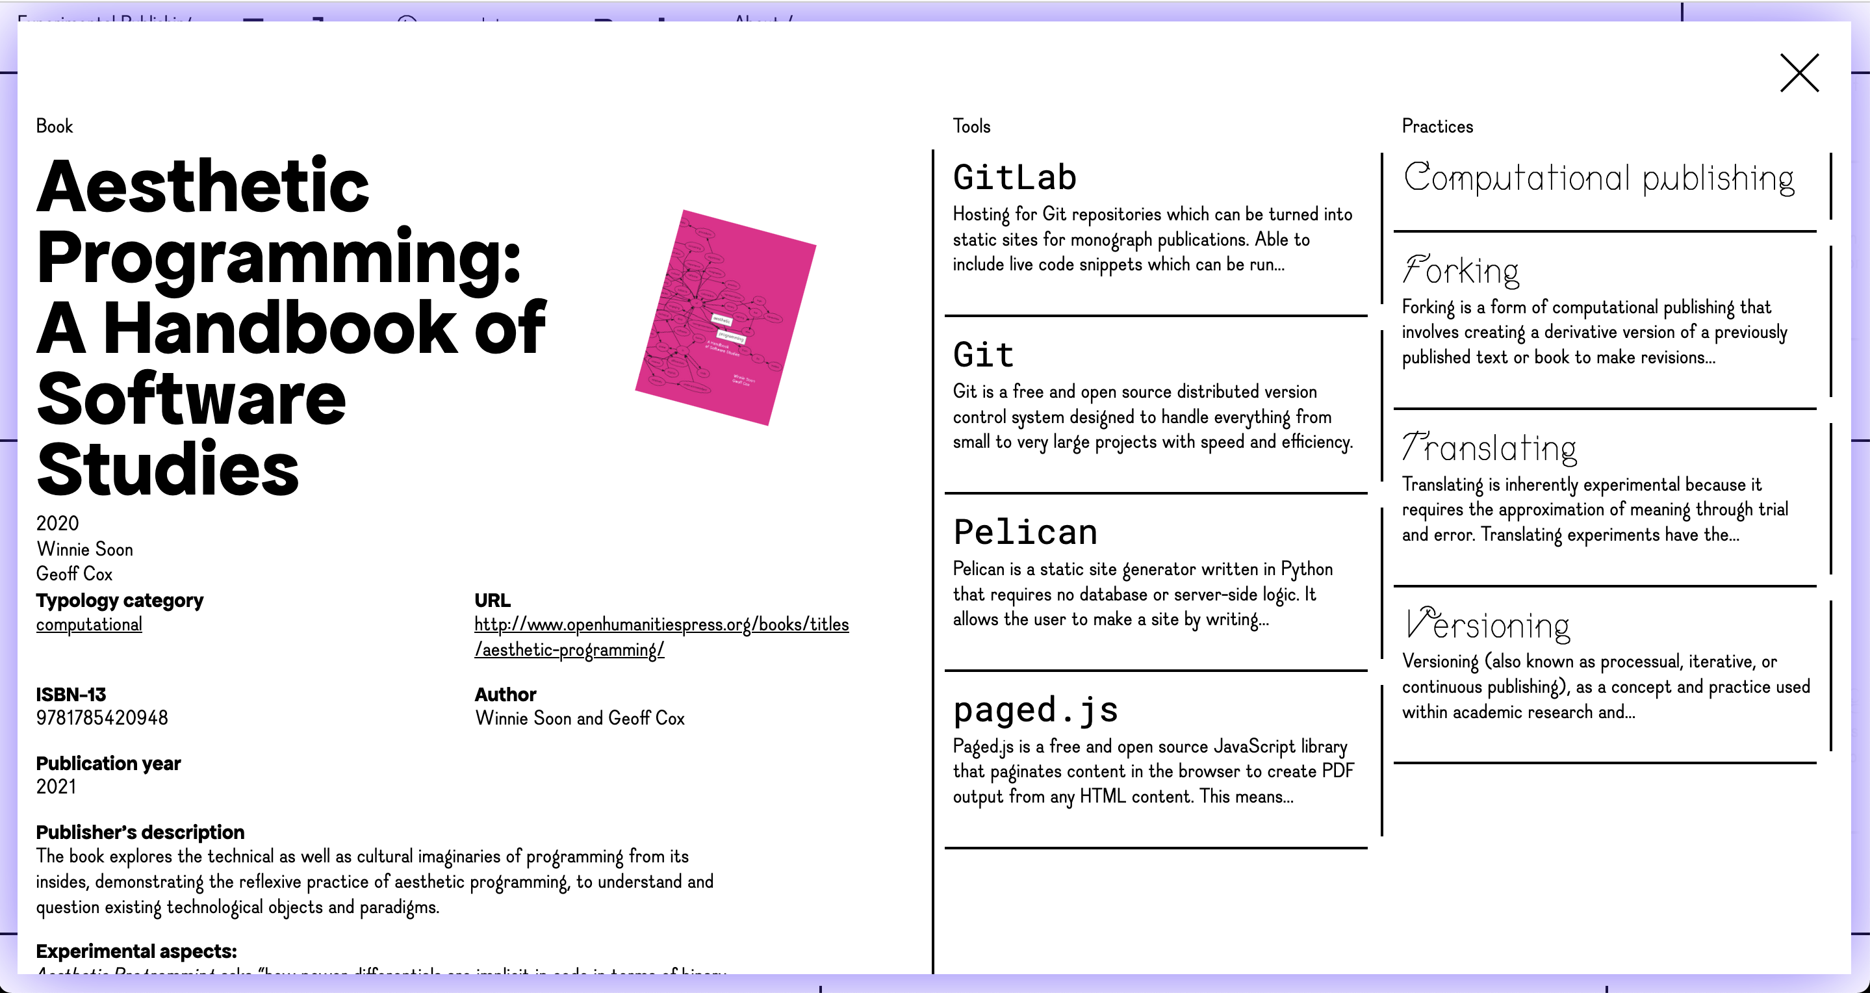

Slide 16
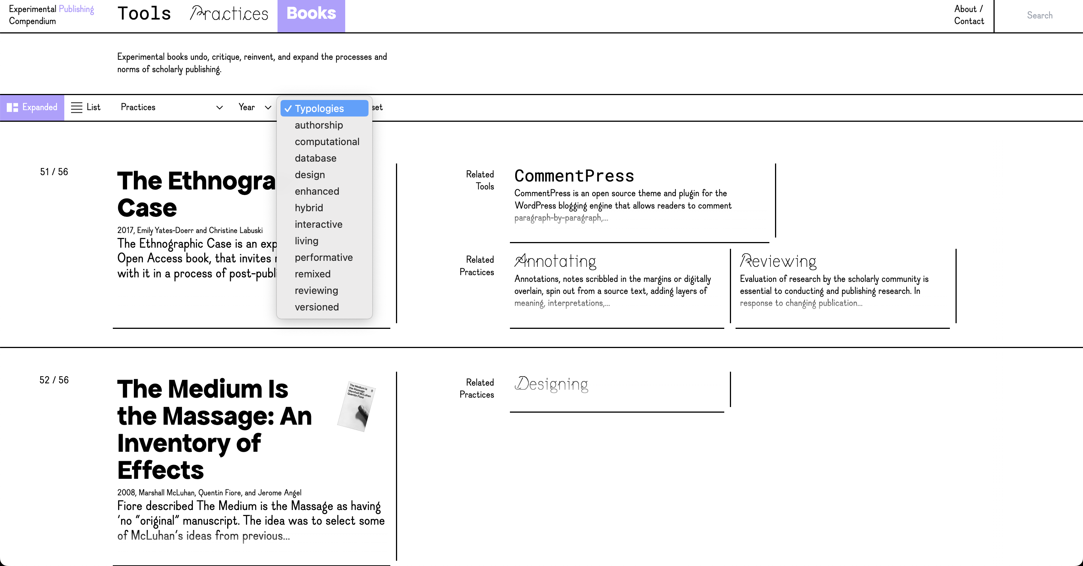

Slide 17
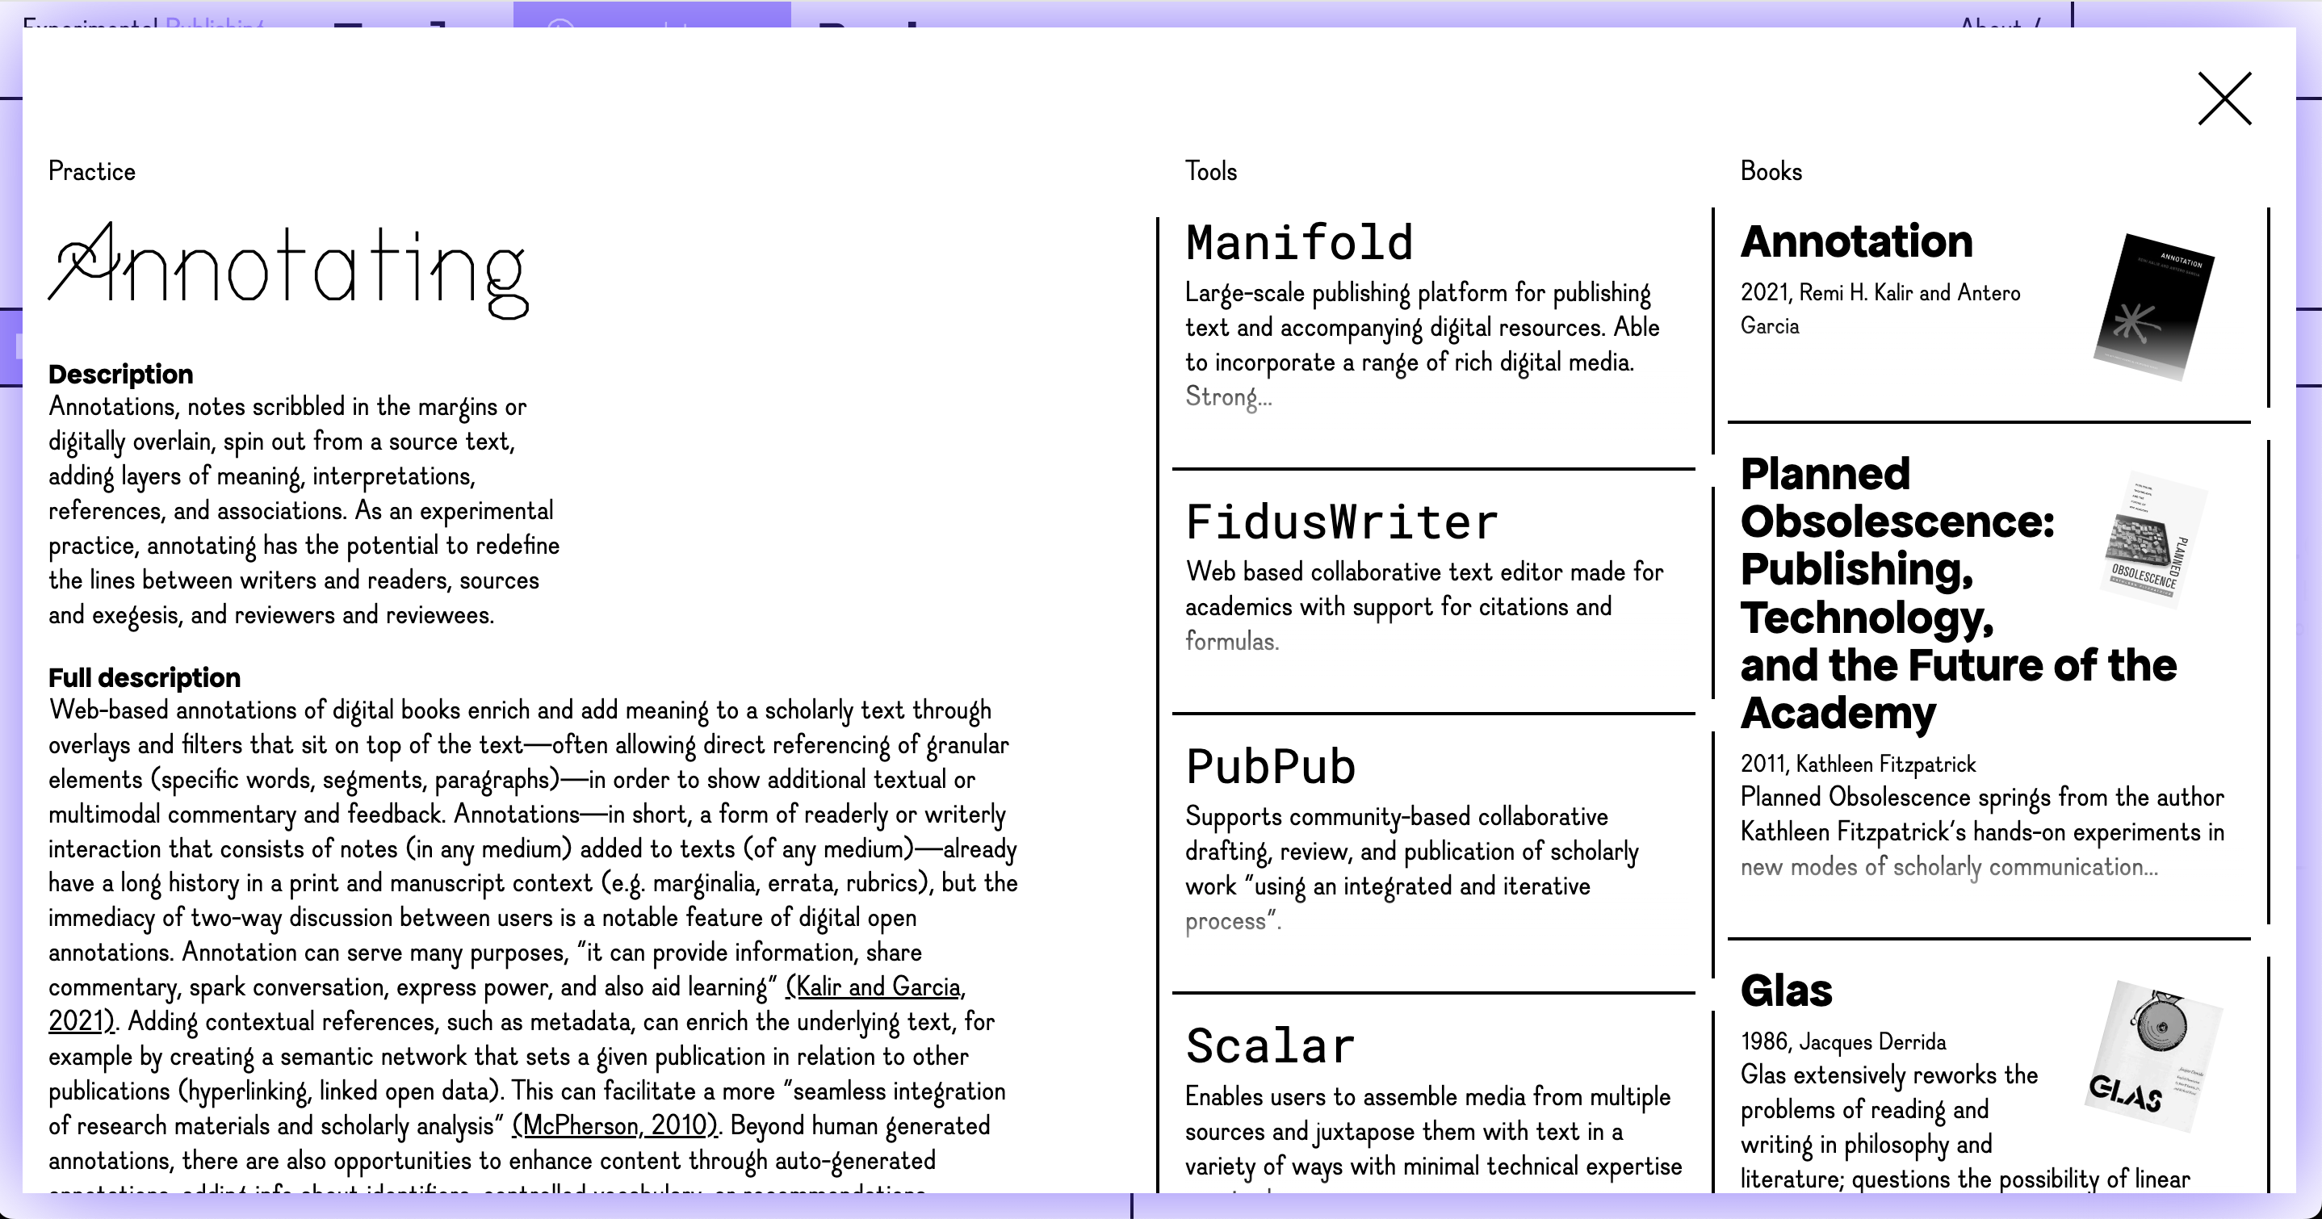

Slide 18
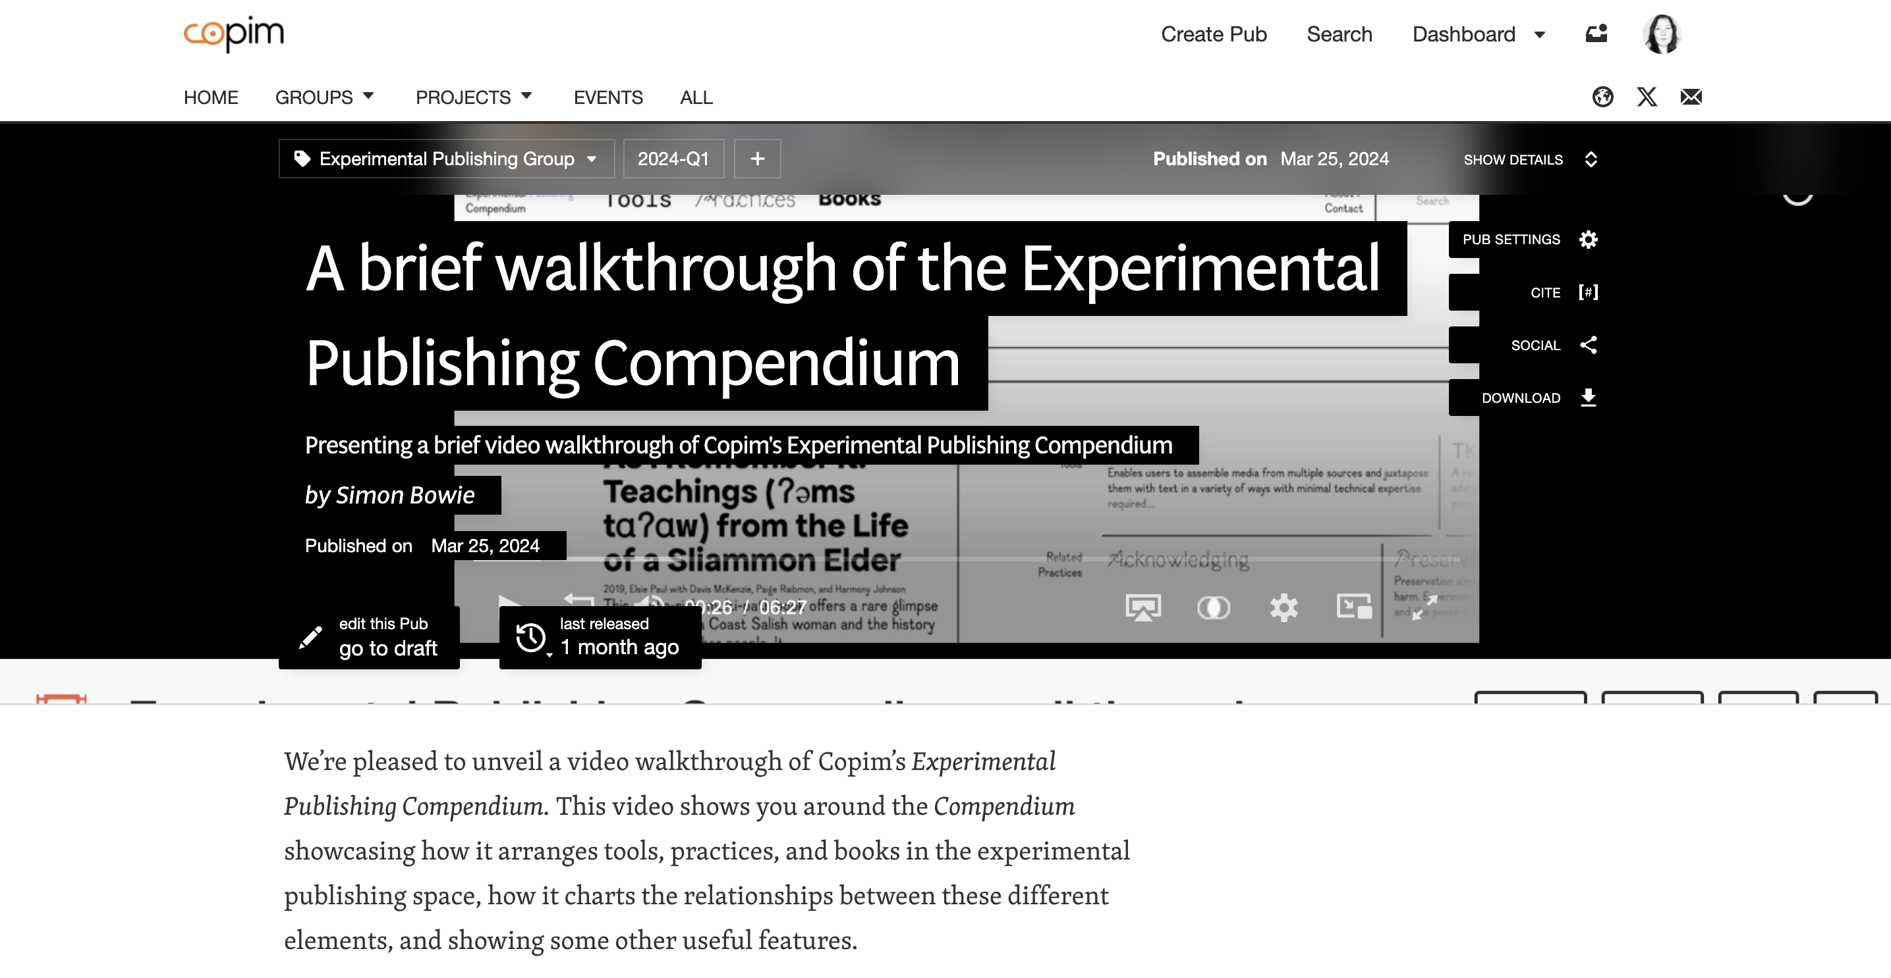
Video walk-through of the Experimental Publishing Compendium
https://archive.org/details/Experimental_Publishing_Compendium_walkthrough

