Slide 1
Posthumanities Publishing
Janneke Adema and Gary Hall
Centre for Postdigital Cultures
Coventry University
SESSION 1:
THE CARRIER BAG THEORY OF NON-FICTION
Urgent Publishing

Slide 2
“helping cultural bits move around more easily”
Lev Manovich
The Language of New Media

Slide 3
“a logic of the fragment or the chunk, a way of seeing the world as discrete modules or nodes, a mode that suppresses relation and context. As such, the lenticular also manages and controls complexity.”
Tara McPherson
‘Why Are The Digital Humanities So White?’

Slide 4
forms of experimental publishing: hybrid, enhanced, remixed and multimodal, iterative, and living, webtexts and post-digital works
alternative forms of distribution: piracy, P2P file-sharing, radical open access, wikis, distributed networks, postdigital print
and distributed authorship practices: collaborative, anonymous, including personas, aliases, pseudonyms, as well as machinic, automatic, generative, and algorithmic authorship

Slide 5
”What are the implications of the decentering of the human and of the rise of digital technologies for the humanities, for theory, for how we practice the (digital) humanities, for how we create, perform, disseminate and access it?”

Slide 6
Living Books about Life (Open Humanities Press)
livingbooksaboutlife.org

Slide 10
photomediationsopenbook.net

Slide 11
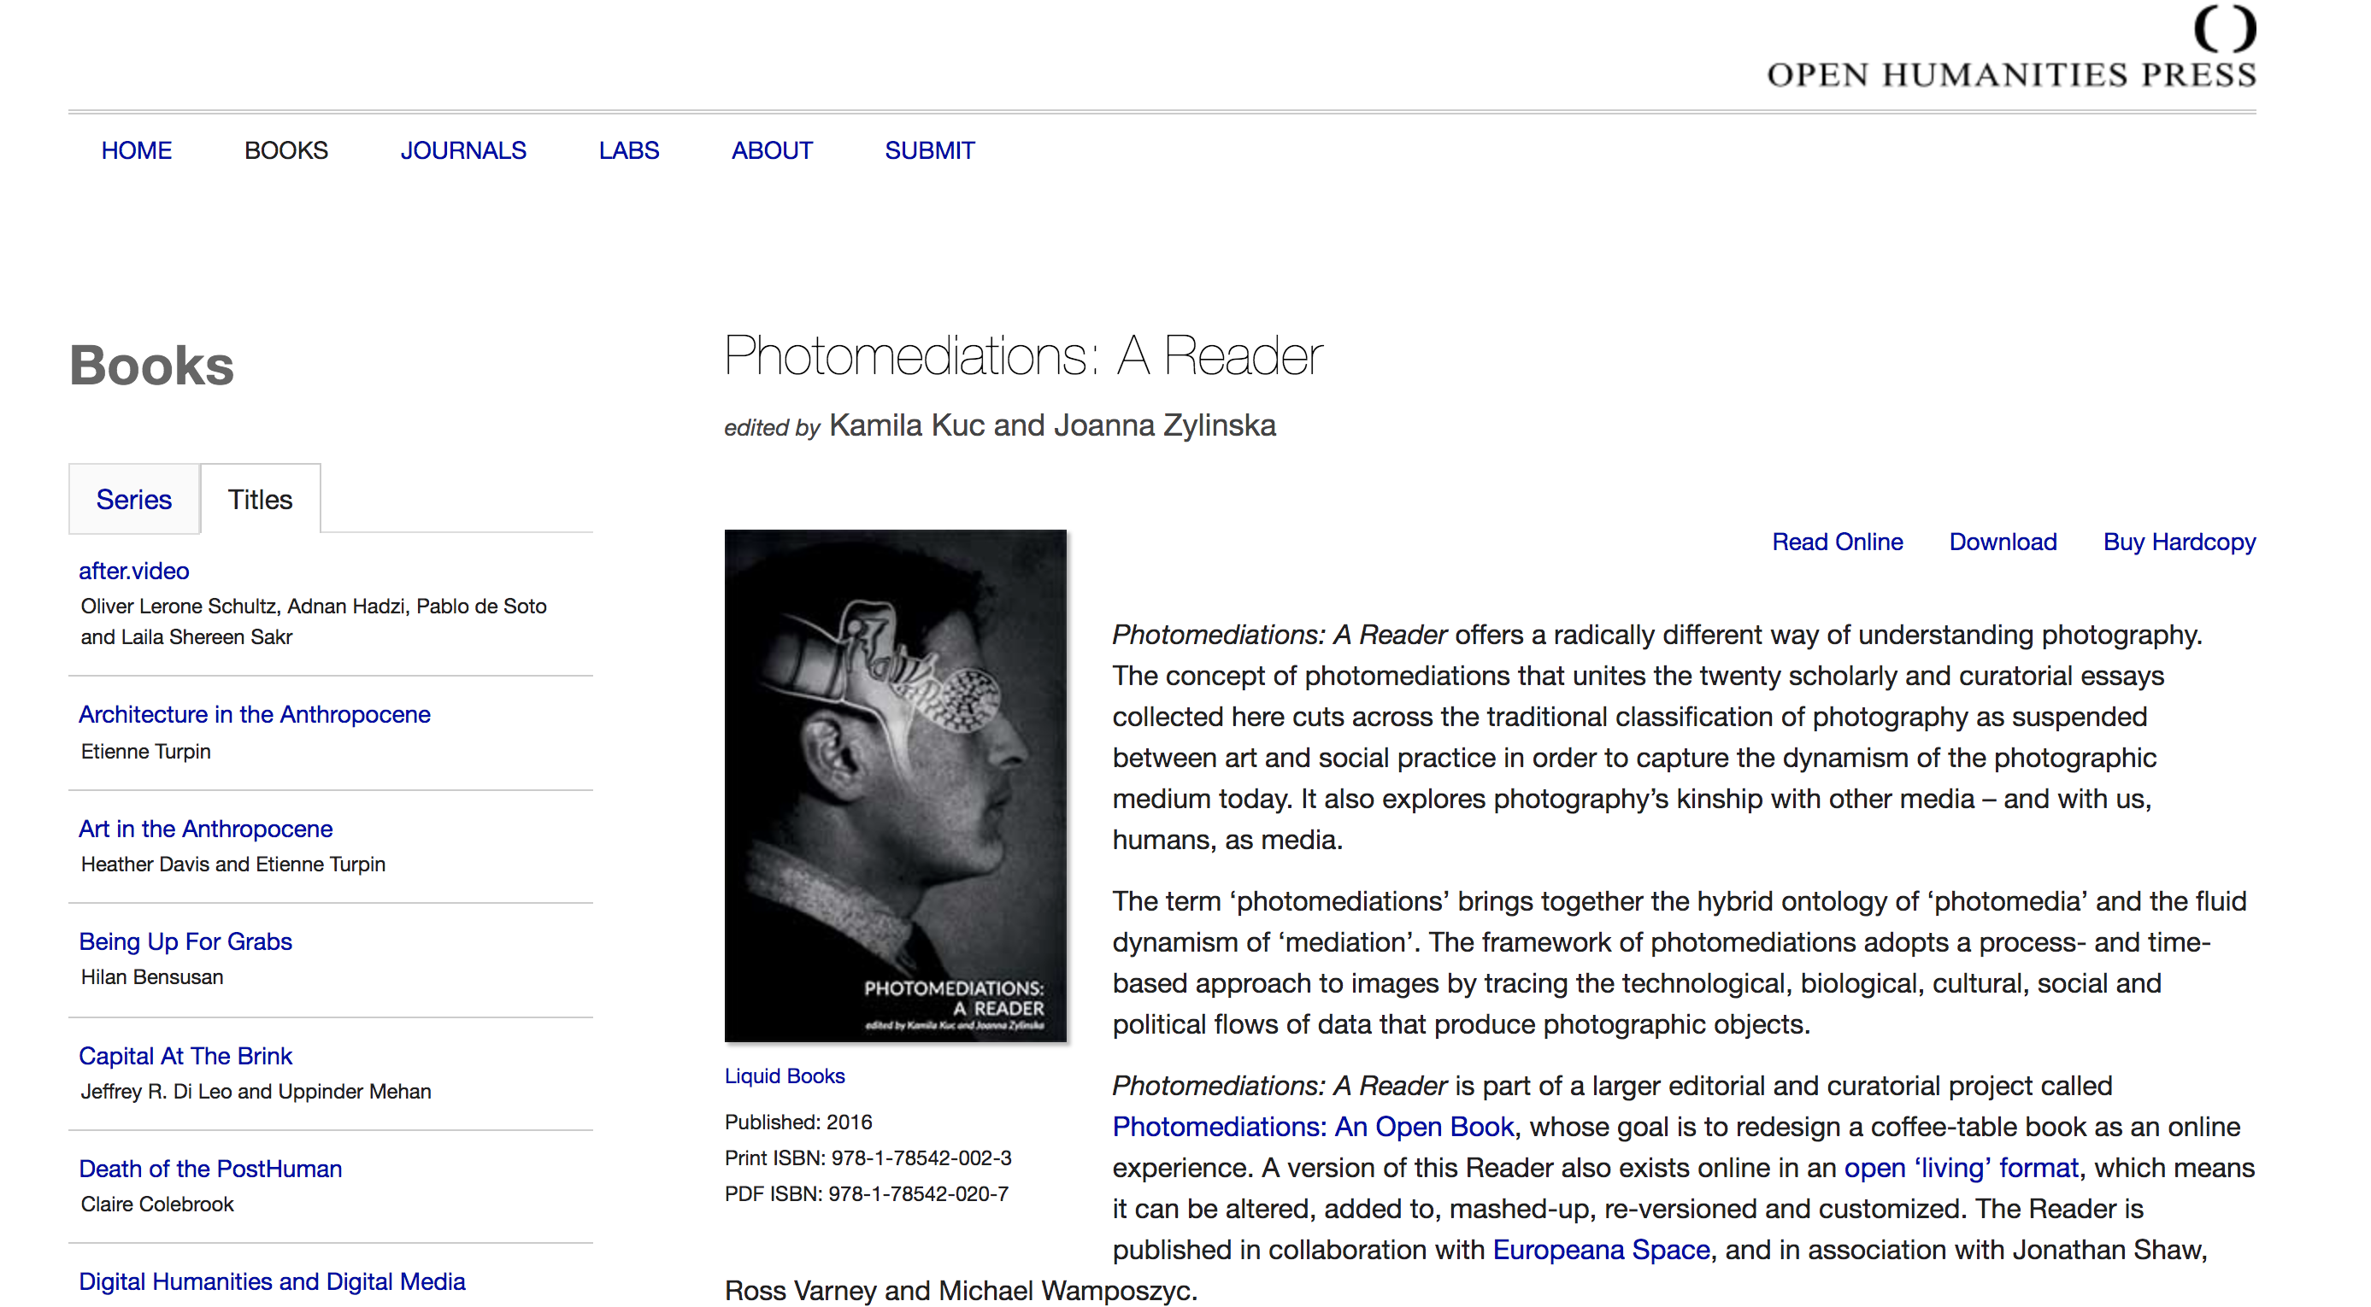

Slide 12
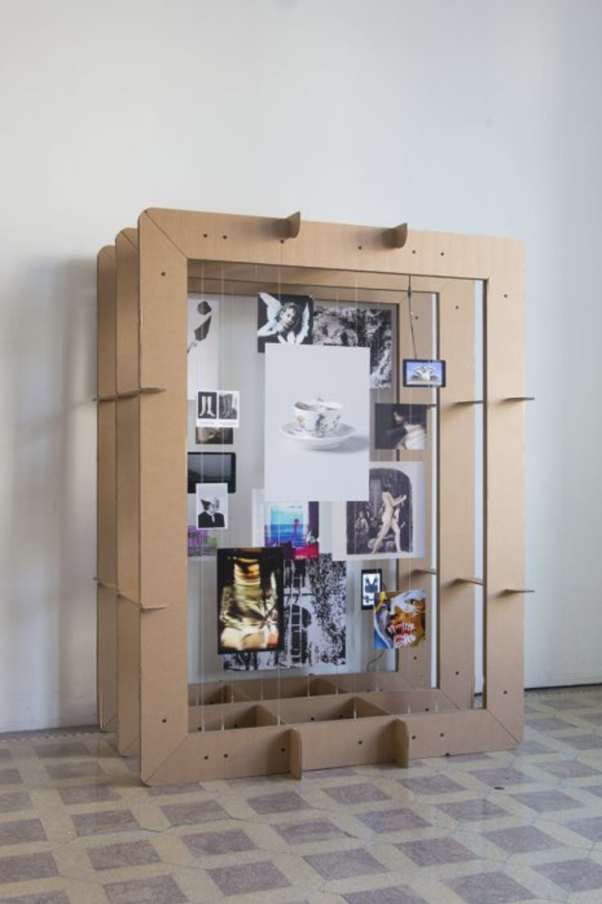
photomediations.disruptivemedia.org.uk

Slide 19
Open Peer Review

Slide 20
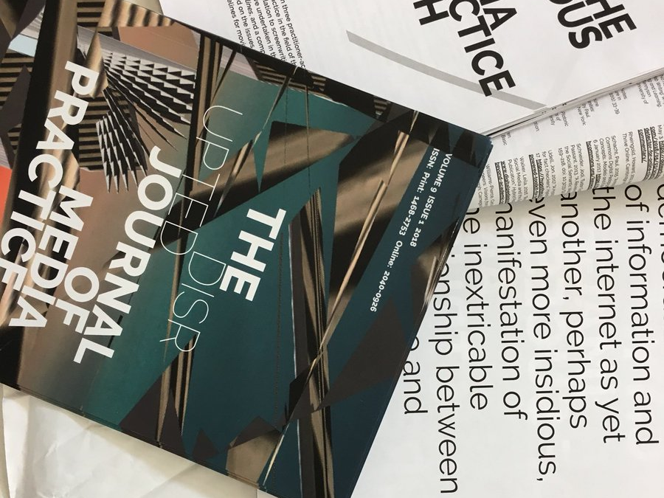
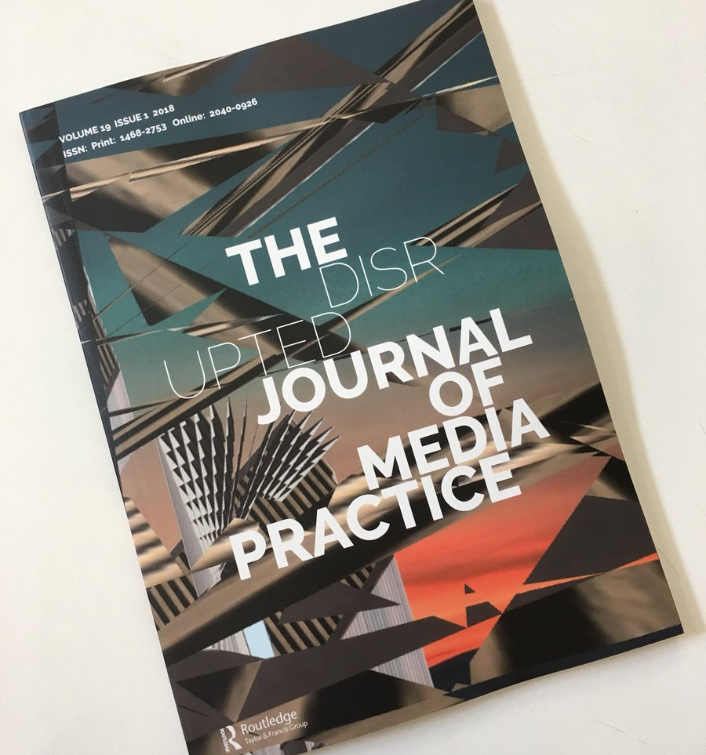

Slide 21
Print design versioning

